Slide 1
Test Plan

Slide 2
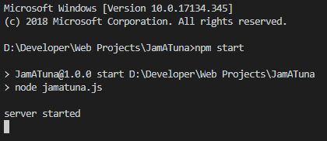
Run Server
Run the following commands in the project directory
npm install
npm start

Slide 3
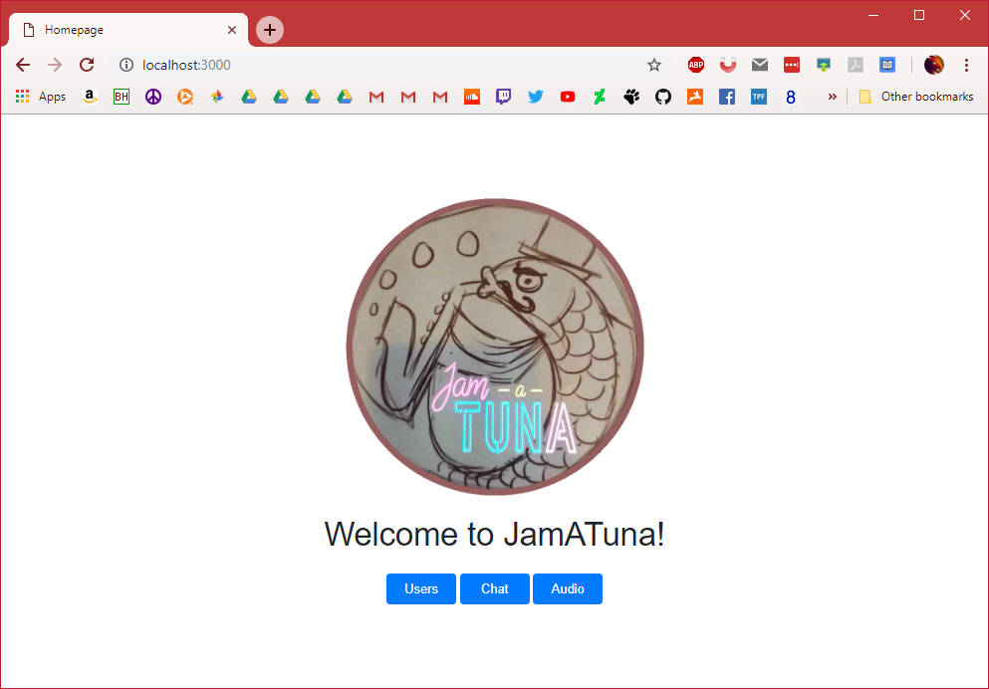
Home page
Navigate to http://localhost:3000/
Should see Jam-a-Tuna image, text, and buttons
All buttons should work by taking you to a new page
Page should be centered in middle of browser

Slide 4
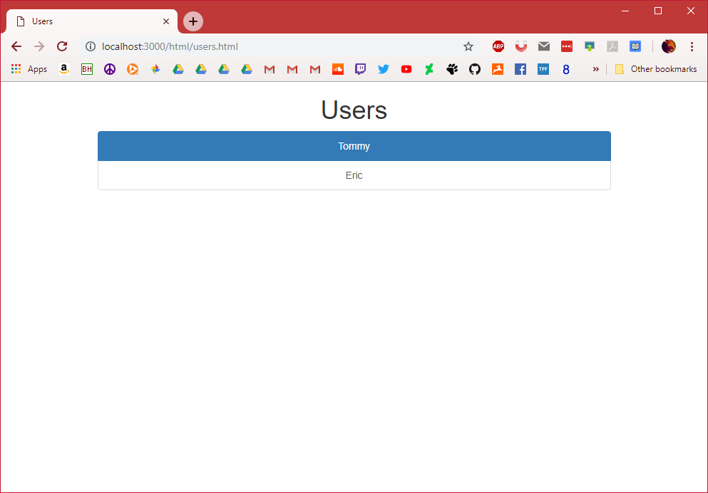
Users page
Navigate to http://localhost:3000/html/users.html
Should see list of users
Each user should be clickable

Slide 5
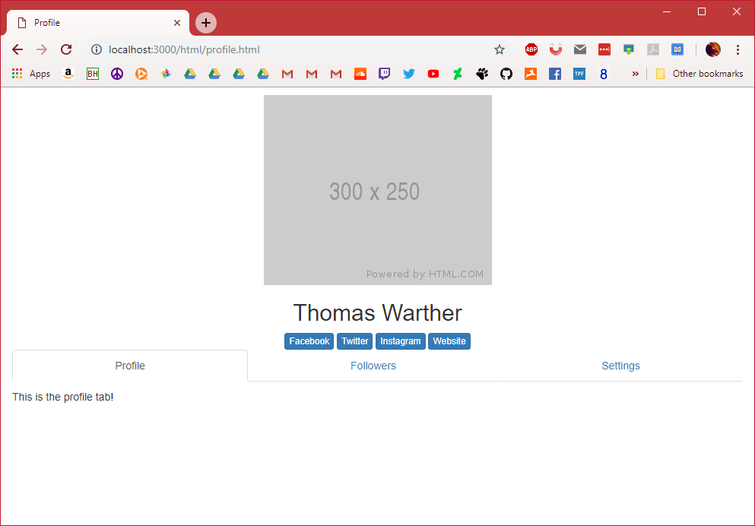
Profile page
Navigate to http://localhost:3000/html/profile.html
Should see profile page with tabs
Tabs are clickable

Slide 6
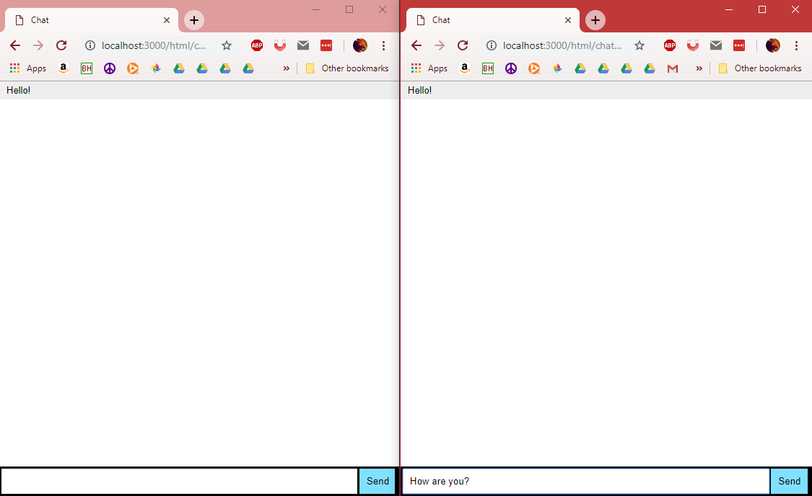
Chat page
Navigate to http://localhost:3000/html/chat.html
Open two browser tabs
Type messages into either tab and hit ‘Enter’
Messages should show on both tabs

Slide 7
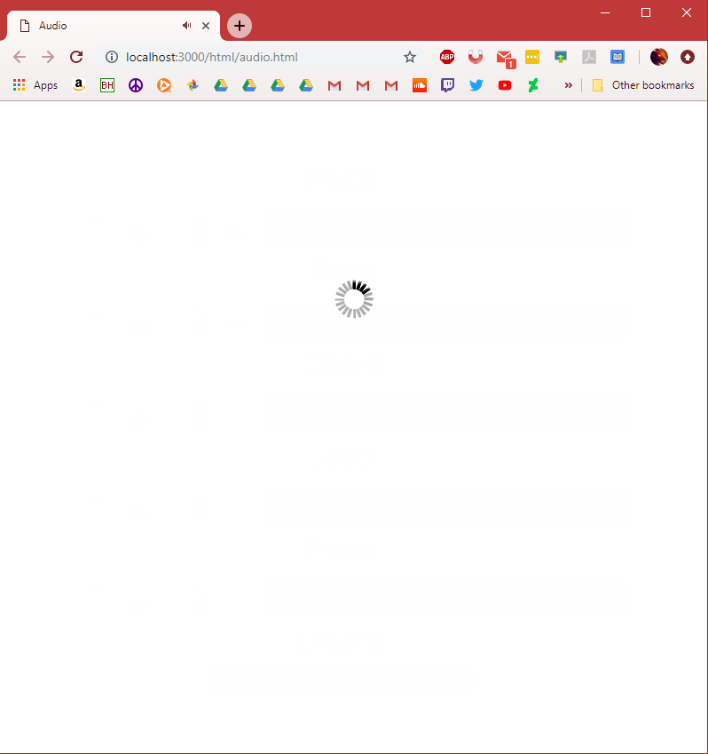
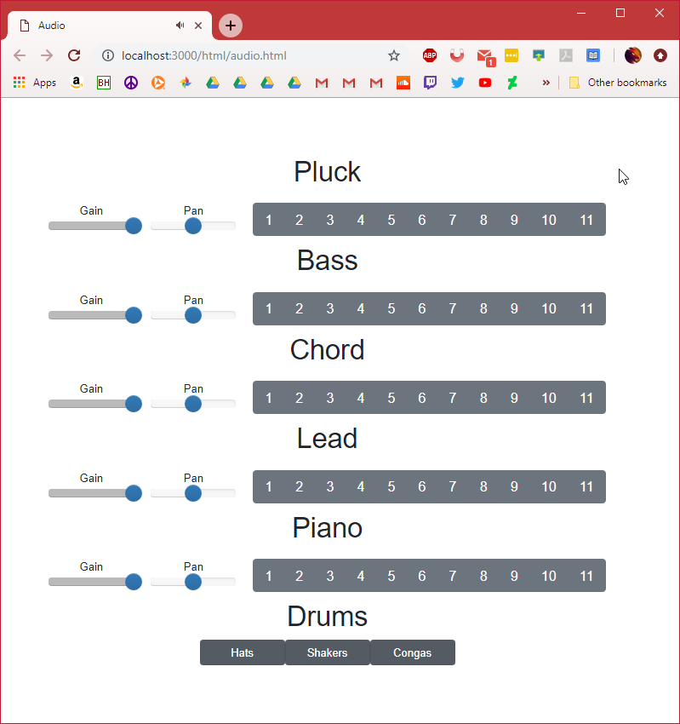
Audio page
Navigate to http://localhost:3000/html/audio.html
Loading screen should appear first
Should see title and buttons centered in screen after
Drum beat should start

Slide 8
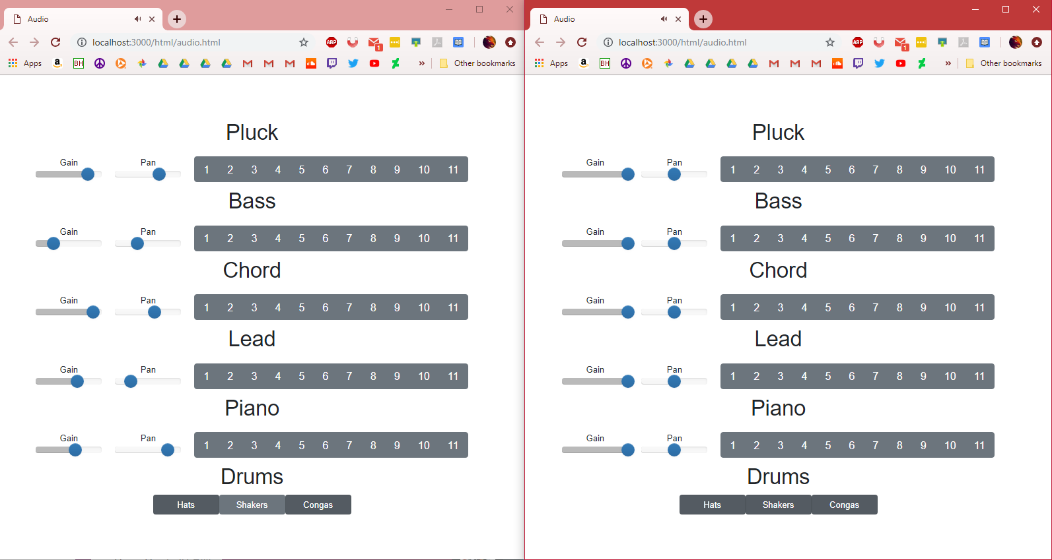
Audio page
Continued
Pressing a button on either tab will play an audio file
Audio files should be played on both tabs
Sound should be in sync no matter how irregular clicks are made
Gain and pan sliders should work

